Slide 1


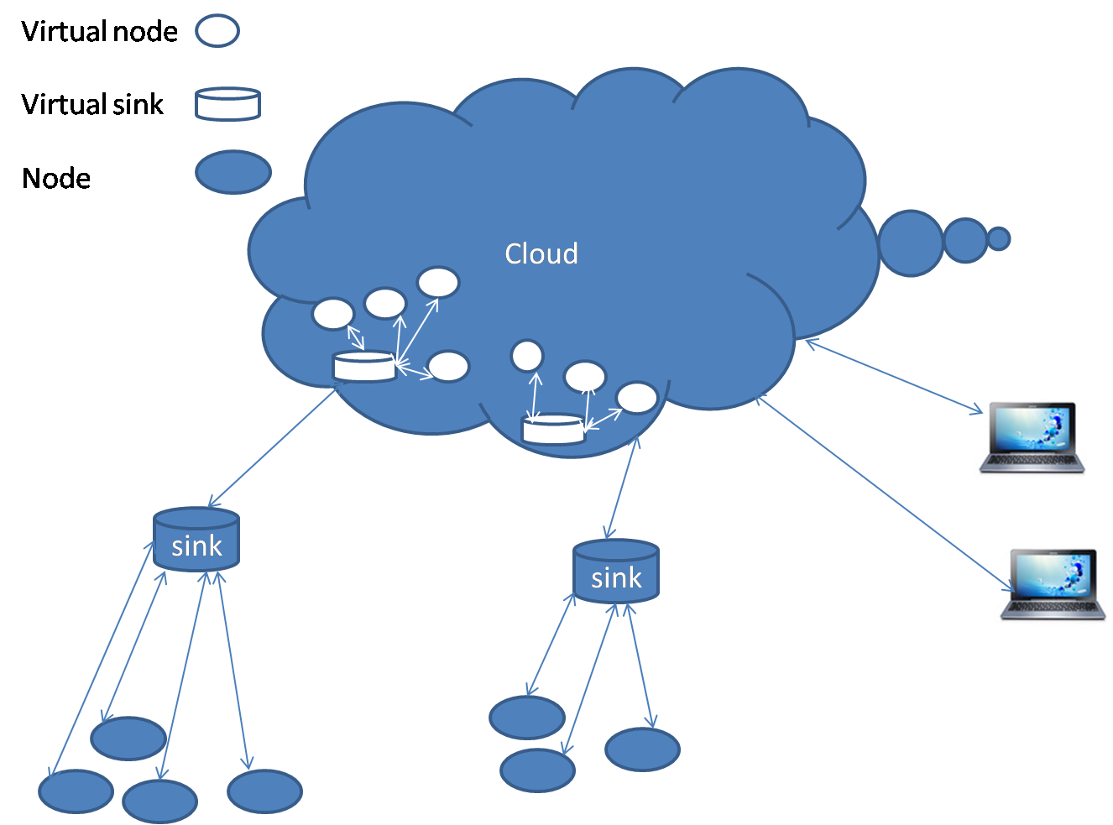
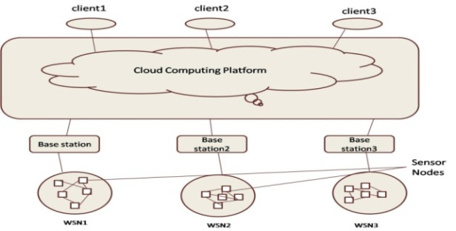
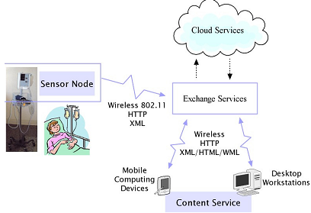
The Study of Cloud Computing in Wireless Sensor Network
Anjana Tiha (0505071)
Problem Definition
Methodologies
Cloud Solution: Hadoop Cloud Architecture
Comparison of Services
Sensor Network consists of nodes. To access, sensor virtualization is required. Sensors are limited energy resource. In cloud sensor integration we would like to focus on energy efficient solution for sensors and introduce some cloud solution.
Sensor Network:
Homogeneous sensors form a WSN, heterogeneous sensors form logical independent, physically overlapped WSNs
Sensor nodes are divided into clusters
Each zone has a cloud virtual sink point
Clouds’ distributed manner facilitates parallel processing
Cloud Network:
Proposes master-slave
structure for storage
and data processing.
Master is responsible for storing meta data and scheduling tasks and slaves are responsible for storing content or job execution.
 | Data Collection For Patients | Traffic Monitoring | Weather Forecasting
Number of Nodes | Relatively low | Very High | High
Deliverable services | Tele presription Mobile health alarm Remote patient monitoring Patient data backup | Traffic signal control Toll collection Parking guidance Speed violation detection Collision avoidance | Detects – Wind speed/direction Relative humidity Temperature Moisture Pressure Radiation
Sensor Devices | Mobile phones Weight scale Stethoscope, X-ray | CC Camera Video Sensors Speedometer | Barometer Seismometer Anemometer
Service Level | SaaS | SaaS | SaaS and IaaS
Resource need | Low | High | Very High
Connection | Wi-Fi, Bluetooth | Wi-Fi | Wi-Fi
Objective
The main objective of the poster is to develop an algorithm to select most efficient Sensor during incoming sensor accumulation request. We would also like to propose existing cloud solution for integration of cloud sensor network.
Limit energy cost
Make optimal use of sensors
Keep track of all the sensors
Track sensor state
1.Take input from user:zone,time,functions
Cloud calculates energy cost from time and function.
2.Selects virtual zone
3.Fetch list of active nodes in zone
For i nodes iterate
if node energy >energy cost
select node
if(node is not active)
activate node;
break out of loop;
If(iteration complete)
break out of loop;
else
continue;
If time>calculated time
deactivate node
hand control to cloud
Data Collection For Patients:
Sensors can be inter-connected.
Data from sensors are sent to central sink
then to Cloud.
Cloud analyzes and
distributes the data.
Traffic Monitoring:
Sensors with embedded network capability installed along roadside.
Sensors will communicate with the neighbouring nodes to develop a global picture.
Weather Forecasting:
Large storage requirement for weather forecasting sensors can be met through cloud .
Complex computations can be done on remote network of cloud
Applications
Methodologies
User give inputs of time and zone, function from computer devices
Cloud analyzes the time required using database where time required for each function is calculated
Cloud selects the required zone
Cloud selects suitable sensor and sensor parameter for user, using algorithm
Challenges
Though cloud architecture is scalable, sensor network cannot expand as well. Power limitation is also an issue. Sensor-cloud integration deals with vital data and needs to ensure confidentiality and integrity both during transmission and storage using encryption and cryptography.
Conclusion
Outcome
In spite of these limitations, cloud combing with WSN promotes a very rich platform for delivering client based services that was limited by WSN stand-alone system.
In this method nodes will not be active all the time. Upon user request nodes will be turned on and start collecting parameters from environment mode. All the time the nodes will be semi active mode.
Acknoledgement
Thanks to Madam Dr. Mahmuda Nazeen for all her support and guidance.
Department of Computer Science and Engineering (CSE), BUET

